Slide 1
Network Infrastructure Design and Implementation 2nd group
Work of:
Budai József
Csépányi Bárdos Letícia
Berki Dorina

Slide 2
Introduction
Our task was to design, test and implement a network infrastucture for a medium-sized company's three locations. The goal was to build a stable, secure, and scalable network that ensures the smooth operation of business processes and allows employees to work efficiently, whether on-site or through remote access.

Slide 3






Project planning
Programs/softwares used:
Cisco Packet Tracer
Github
PowerPoint
Word
VirtualBox
AWS Academy

Slide 4
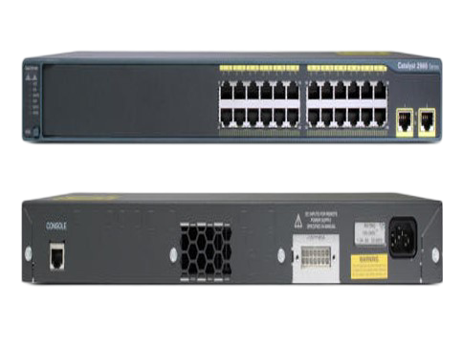
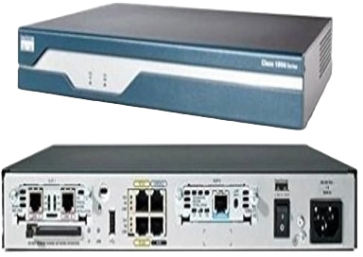
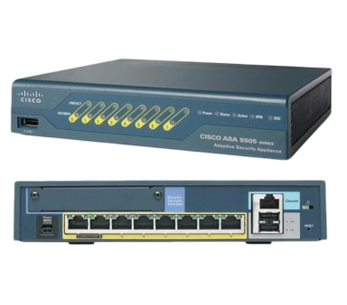
Devices Used
1841 Router
2960-24TT Switch
We also used switches for interconnections and VLAN management, as well as an ASA firewall for security purposes.
We used routers to establish the connection between the three sites, where DHCP is used for IP address allocation and HSRP is implemented for redundant connectivity.
Cisco ASA 5505
Cisco ASA 5505

Slide 5
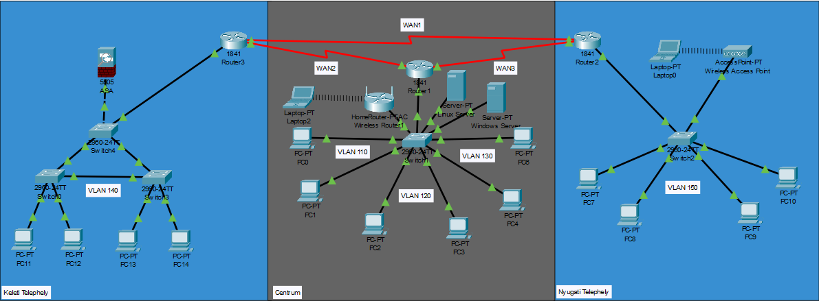
Physical Topology
East Centrum
West

Slide 6
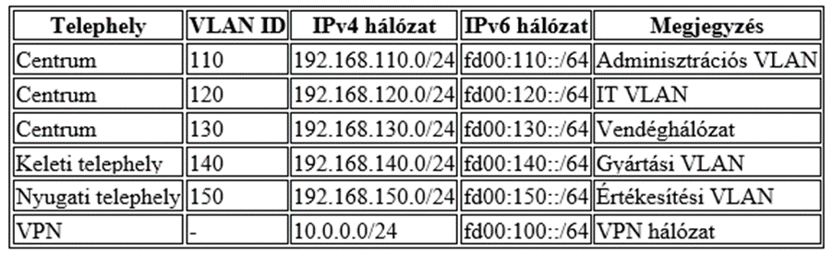
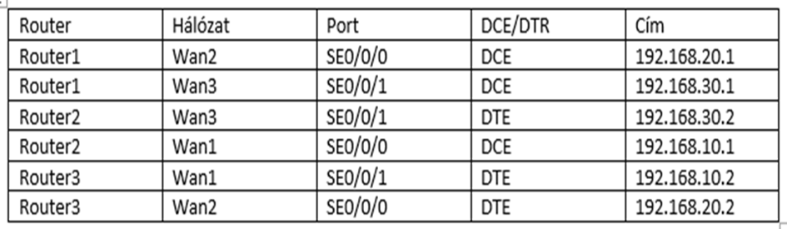
Logical Topology
East site:
Manufacturing VLAN (VLAN 150) to isolate control systems.
VPN connection with the main office.
Local DHCP and DNS services and redundancy.
Centrum:
VLAN-configuration:
- VLAN 110: Administration
- VLAN 120: IT
- VLAN 130: Guest Network
WLAN access provided (802.1X authentication).
Static and dynamic IPv4/IPv6 support .
Redundant network connections.
West site:
Sales VLAN (VLAN 140) to isolate customer data and business applications.
Local DHCP and DNS services and redundancy.
NAT/PAT Dynamic Address Translation.
IP Address Table
WAN Address Table

Slide 7
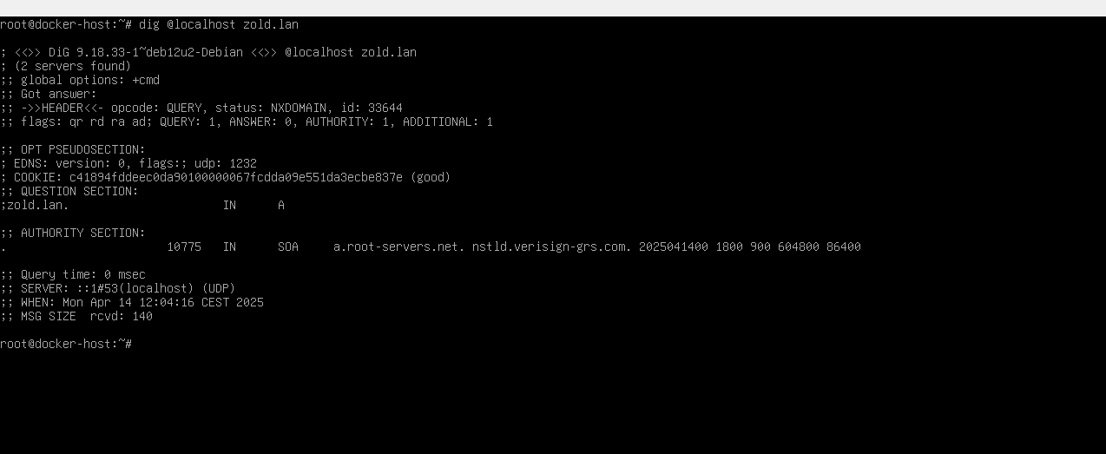
Testing and Documentation
Pings and Traceroute Tests: Checking availability, network routes and connections
Testing ACLs and VLANs: Verifying the functionality of security measures and segmentation settings
Redundancy Testing: Simulating the proper operation of HSRP/VSRP and other redundant solutions by simulating failure scenarios
Documenting the process and results

Slide 8
Configuring devices
Technologies we have used to configure the devices:
DHCP (Dynamic Host Configuration Protocol),
VLAN (Virtual Local Area Network),
OSPF (Open Shortest Path First),
WAN (Wide Area Network),
VSRP, HSRP (Virtual Switch Redundancy Protocol, Hot Standby Router Protocol),
VPN (Virtual Private Network),

Slide 9
Group work division
Berki Dorina: Linux server, DHCP, DNS
Csépányi-Bárdos Letícia: Documentation, Hungarian-language presentation
Budai József: Network topology creation and programming, English-language presentation.

Slide 10
THANK YOU FOR YOUR ATTENTION!

